Slide 1
Hunting Software Bugs Using Machine Learning
Mayur Naik
University of Pennsylvania

Slide 2

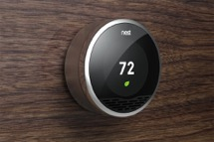

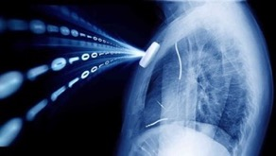

Software Is Becoming Increasingly Complex
Software Complexity
100 million LOC
4.10
15 million LOC
2.5
3.3 million LOC
4 million LOC
2002
Year
2017
Notes:
Programs are becoming increasingly complex. 15 years ago, an OS kernel contains 3.3 million lines of code.
Nowadays, even a mobile application contains 4 million lines of code,
While an OS kernel contains 15 million lines of code.
And all the programs in a car together contain 100 million lines of code.
But the complexity of software is not just reflected by the size.
In the past, the primary computing platform is personal computers.
Nowadays, the computing environment has become highly heterogeneous.

Slide 3
The Challenge of Scaling Current QA Methods
World Quality Report 2015, Capgemini
40%
2018
Software QA Budget
35%
23%
2014
(projected)
18%
2013
2012
Year
Notes:
At the same time, software development hasn’t kept up the pace.
The primary methods for quality assurance are still testing and code review, which require a lot of manual efforts.
As a result, IT companies are spending more and more budget in ensuring software quality.

Slide 4

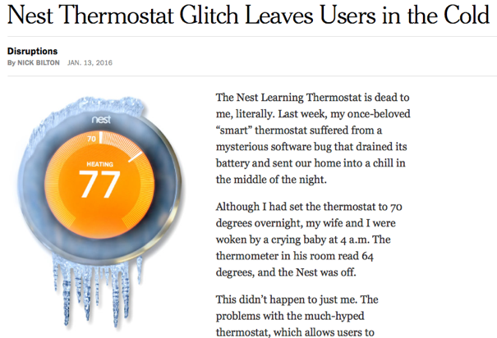
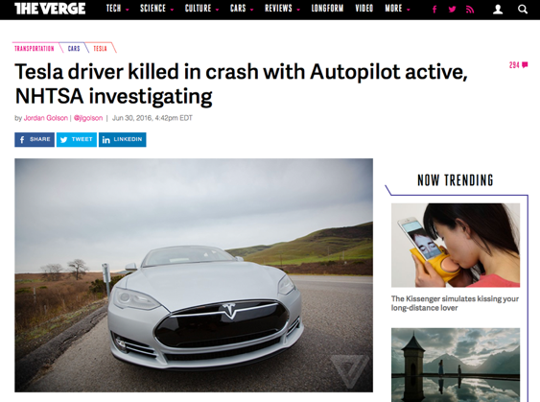

When Software Fails
Notes:
Despite all the investment, software still fails quite often in practice.

Slide 5
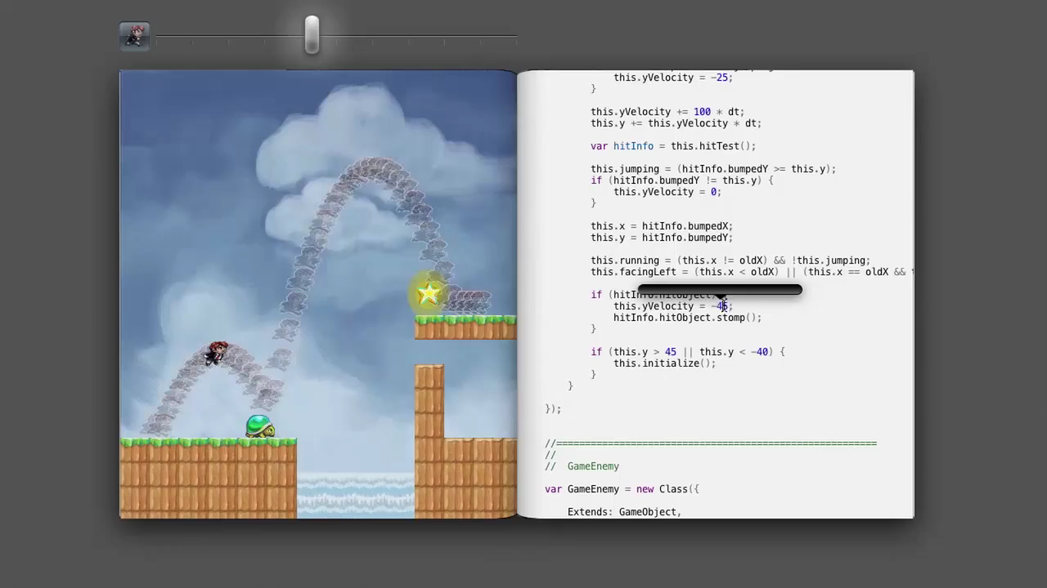
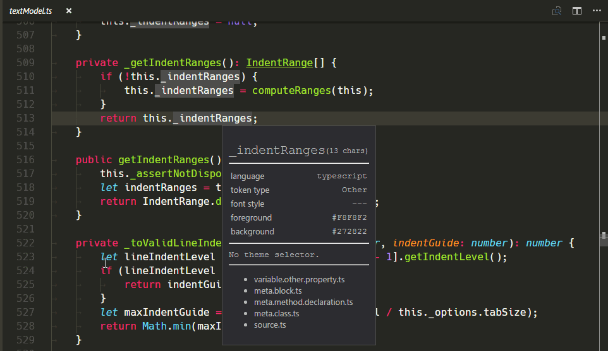
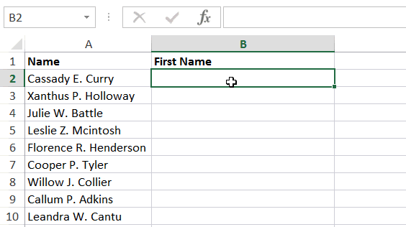
Approaches to Software Reliability
Language Design
Program Analysis
Program Synthesis

Slide 6
Program Analysis: State of the Practice
Astrée
Microsoft
Windows Device Drivers
Airbus
Aircraft Control Software
Synopsis
Enterprise Applications
Facebook
Mobile Applications
Notes:
Program analyses, as many of you might know, are algorithms for discovering useful facts about programs.
There are many success stories about applying program analyses in industry. For example. SLAM employs model-checking and is the underlying engine of Microsoft Static Driver Verifier, which helped eliminate most of the bluescreen errors in Windows. Astree is a tool based on abstract interpretation and has been used to check the correctness of the airbus flight control software. Coverity, a tool based on dataflow analysis by Synopsis, has helped find bugs in many enterprise applications. More recently, Facebook Infer, a tool based on separation logic, has been deployed inside the company to help improve the memory safety of mobile applications.
Program analysis sounds an effective way to improve software quality, why not apply it more broadly?

Slide 7
Conventional Approach
Program
Analysis
Notes:
Designing program analyses that work in practice remains as much as art as its science
Current approach: Knowledgeable writer designs analyses
Also, needs experience. Uses experience to decide what approximations to incorporate.
Why approximations?
Undecidable problems
Properties ill-defined, For example, consider an analysis trying to find races in the program. Many data races are benign and programmers do want them to be reported. Notion of benign is subjective and not well-defined.
Most large programs call native code i.e code for which we don’t have source code but only the binaries. These are invisible to analysis tools that operate on source/assembly code.
No well defined recipe for choosing approximations. And the guiding principle employed is to choose approximations such that analysis still produces useful results inspite of the inherent imprecision due to the approximations.

Slide 8



Conventional Approach
Program
Analysis
Approximations
Exact solutions impossible to compute
Properties impossible to state precisely
Missing or opaque program fragments
Analysis Writer (Alice)
…
Notes:
Designing program analyses that work in practice remains as much as art as its science
Current approach: Knowledgeable writer designs analyses
Also, needs experience. Uses experience to decide what approximations to incorporate.
Why approximations?
Undecidable problems
Properties ill-defined, For example, consider an analysis trying to find races in the program. Many data races are benign and programmers do want them to be reported. Notion of benign is subjective and not well-defined.
Most large programs call native code i.e code for which we don’t have source code but only the binaries. These are invisible to analysis tools that operate on source/assembly code.
No well defined recipe for choosing approximations. And the guiding principle employed is to choose approximations such that analysis still produces useful results inspite of the inherent imprecision due to the approximations.

Slide 9

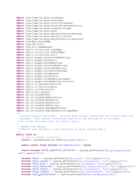

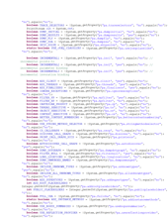

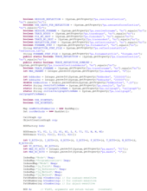
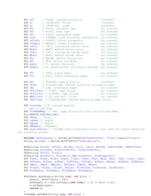
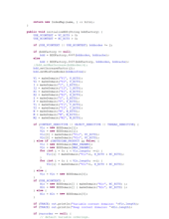
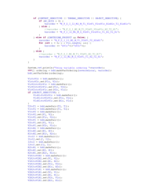
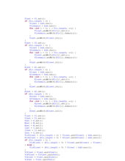
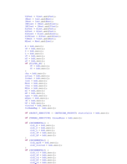
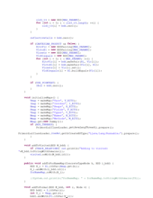
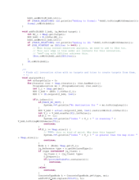
Conventional Approach
People ignore the tool if
more than 30% false positives
are reported …
A Few Billion Lines of Code Later: Using Static Analysis to Find Bugs in the Real World
Coverity Inc, CACM 2010
“
Program
Analysis
”
Analysis User (Bob)
Bug Reports

Slide 10
Our Solution: An Interactive Approach
Program
Analysis
Analysis Writer (Alice)
Analysis User (Bob)
But, many challenges …
What is the nature of the user interaction?
How do we adapt the analysis to user’s responses?
What guarantees can we provide?
Can we learn the analysis via interaction?
Notes:
- Writer still makes decisions about approximations.
User can also give feedback to the analysis tool and guide it towards more acceptable results.
Key technical challenges:
Allow both writer and user to systematically interact with the system
Approach should be smart enough to learn from limited user feedback

Slide 11
Summary of Results
Technique | Nature of Interaction |  | Sound? | Optimization Problem | Publication
 | Active or Passive? | Alarms or Causes?
Alarm Classification | Passive | Alarms | No | MAP Inference | FSE 2014
Alarm Ranking | Active | Alarms | No | Marginal Inference | Ongoing Work
Alarm Resolution | Active | Causes | Yes | Information Gain Maximization | OOPSLA 2017
Notes:
Table of 3 approaches: classification, resolution, ranking.
Columns: guarantees (sub-columns: sound? optimal user effort?), kind of questions (sub-column: active or passive? Feedback on?), optimization problem solved, publication

Slide 12
Talk Outline
Challenges in Automated Program Reasoning
Combined Logical and Probabilistic Approach
Using the Approach in Interactive Techniques
Alarm Classification
Alarm Ranking
Alarm Resolution
Conclusions and Outlook

Slide 13
Example: Static Datarace Analysis
Analysis inputs:
next(p1, p2), mayAlias(p1, p2), guarded(p1, p2)
Analysis outputs:
parallel(p1, p2), race(p1, p2)
Analysis rules:
parallel(p3, p2) :- parallel(p1, p2), next (p3, p1).
(2) parallel(p1, p2) :- parallel(p2, p1).
race(p1, p2) :- parallel(p1, p2), mayAlias(p1, p2), ¬guarded(p1, p2).
…
program point p1 is immediate successor of p2.
p1 & p2 may access the same memory location.
p1 & p2 are guarded by the same lock.
If p1 & p2 may happen in parallel,
and p3 is successor of p1,
then p3 & p2 may happen in parallel.
If p1 & p2 may happen in parallel,
and they may access the same memory location, and they are not guarded by the same lock,
then p1 & p2 may have a datarace.
If p2 & p1 may happen in parallel,
then p1 & p2 may happen in parallel.
p1 & p2 may happen in parallel.
p1 & p2 may
have a datarace.
Notes:
Let’s first look at what a conventional analysis looks like. The analysis I am showing is a simplified datarace analysis that is extracted from Jchord. It is specified in a declarative language called “Datalog”, which is very popular for specifying program analyses.
What is Datalog? Datalog is a querying language that originates from the Database community. It is very similar to SQL, except that it supports recursion.
A Datalog program can be divided into three parts: input relations, output relations, and rules.
Relations are used to specify data and are like tables in a Database.
Input relations specify the input data.
There are three input relations for the datarace detector.
All the p’s range over programming points.
The relation next encodes the control-flow graph of the program.
MayAlias contains the pairs of program points that may access the same memory locations.
Guarded contains the pairs of program points that are guarded by the same lock.
Among these three relations, only next is directly computed from the source code.
Both mayAlias and guarded are calculated by the Datalog analysis. For simplicity, we elide the part computing them and treat them as inputs.
Output relations specify the output data.
There are two output relations. Parallel contains the pairs of program points that can be reached by different threads at the same time.
Datarace contains the final bug reports.
The logic of a Datalog program is specified by its rules.
All rules are deductive, meaning they represent “if something, then something”.
For instance, the first rule says, if p1 and p2 may happen in parallel, and p3 is a successor of p1, then p3 and p2 can happen in parallel.
The second rule says the parallel relation is commutative.
The last rule specifies the Datarace condition: For a given pair of program points p1, p2, if they may happen in parallel, and they may access the same memory location, then there can be a potential datarace between p1 and p2.
To compute the output relations, the Datalog solver will keep applying these rules until the output relations don’t change any more. In other words, it computes the least fixpoint of the rules.

Slide 14
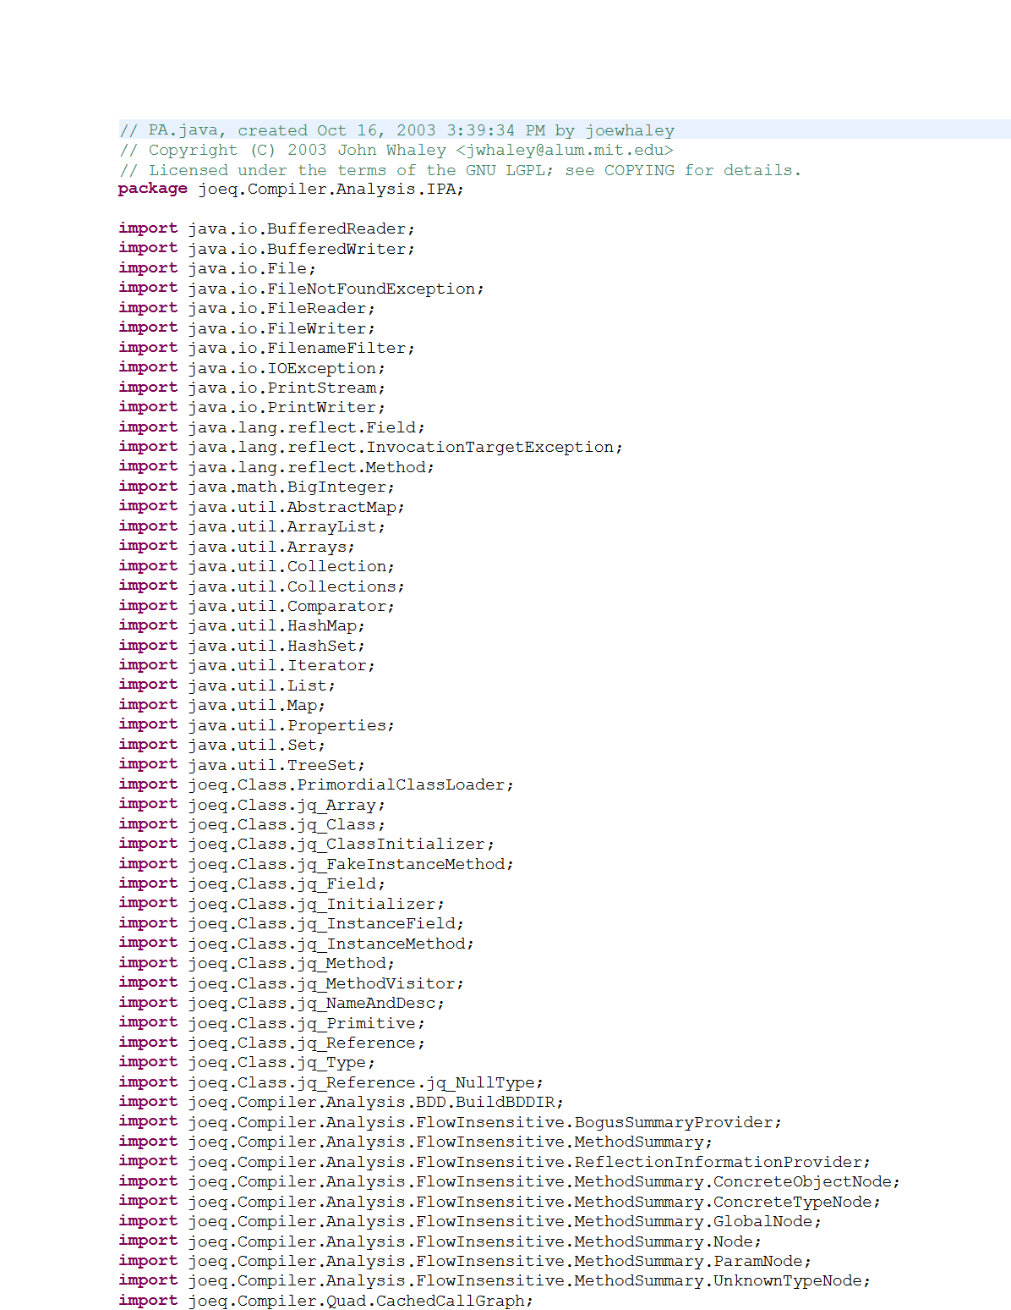
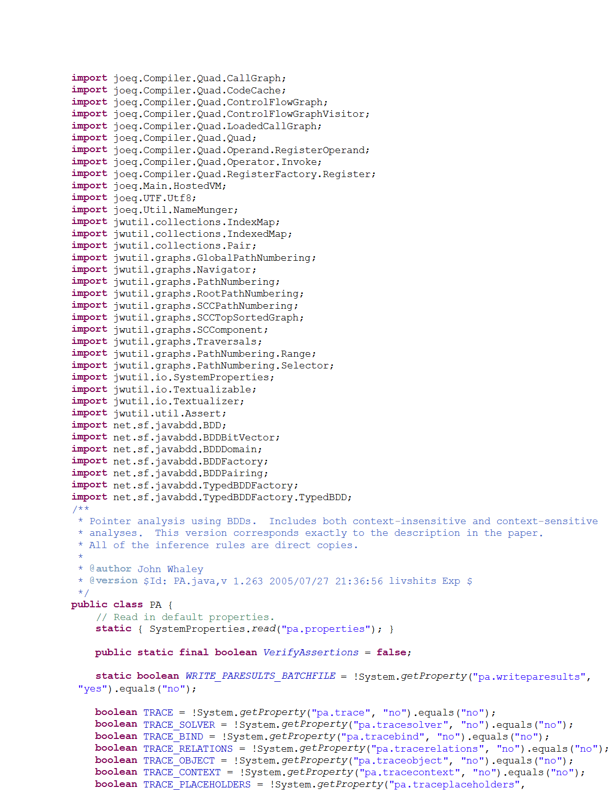
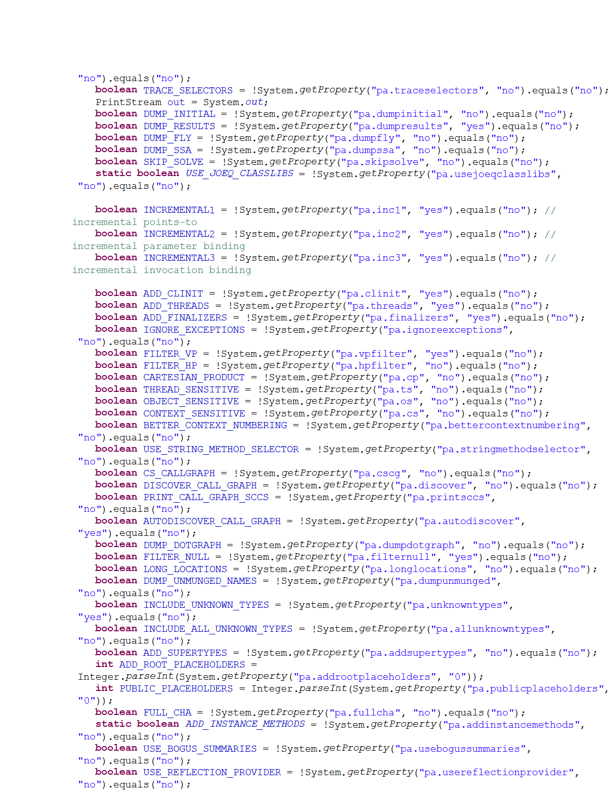

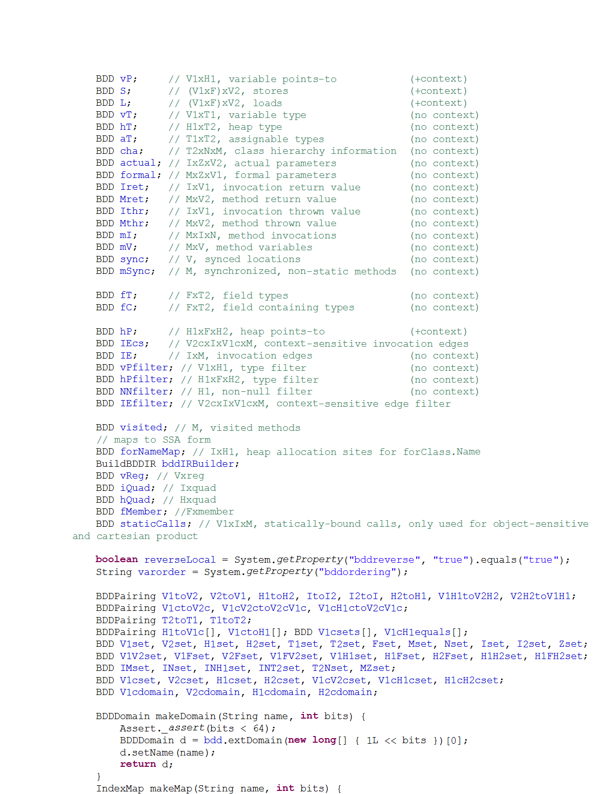
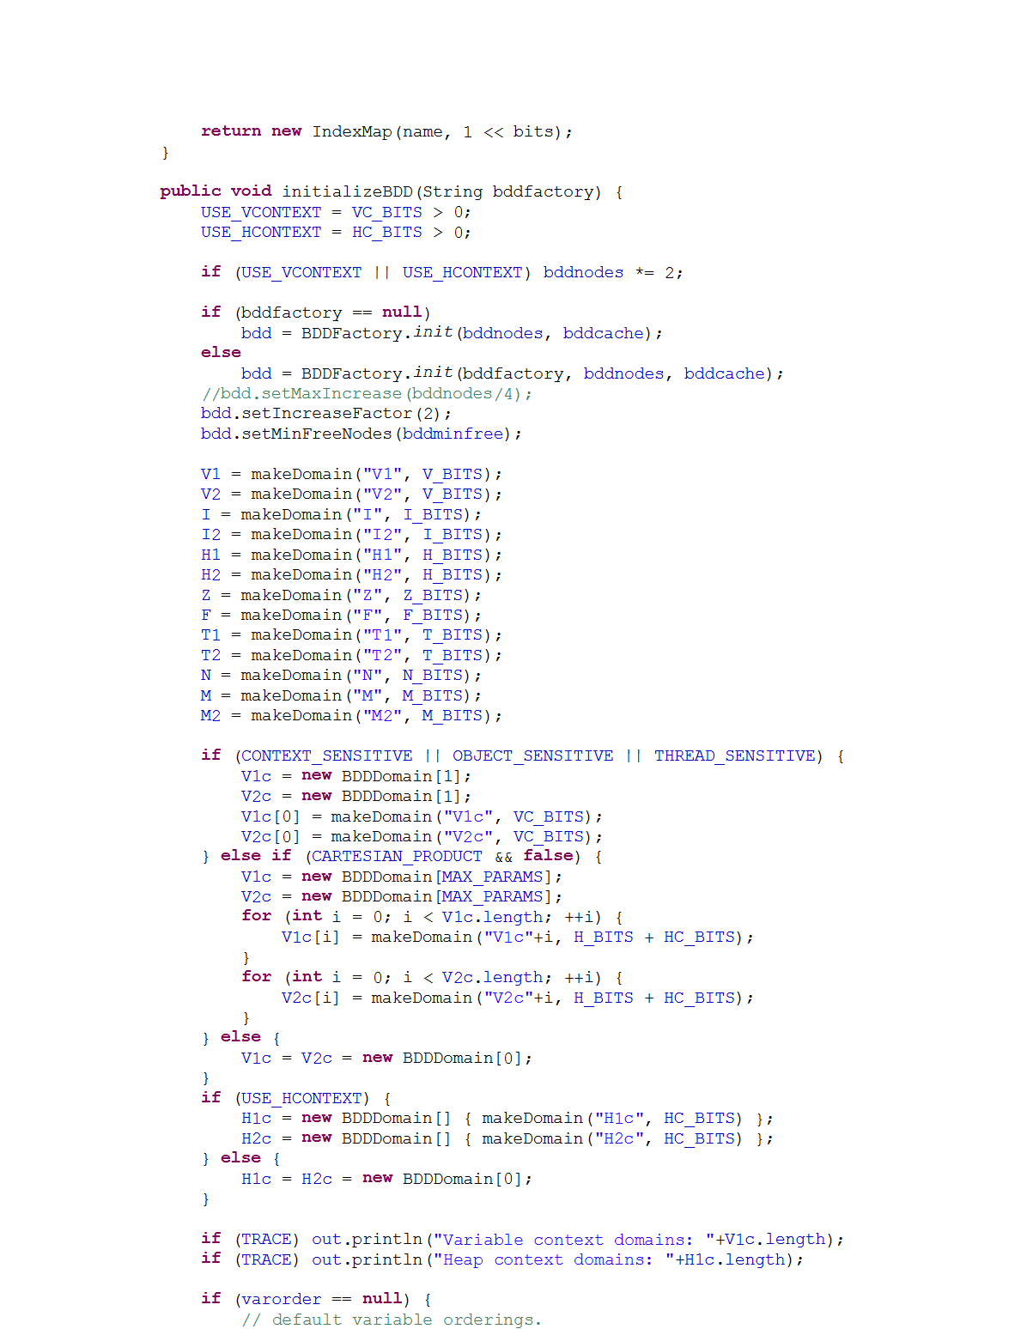
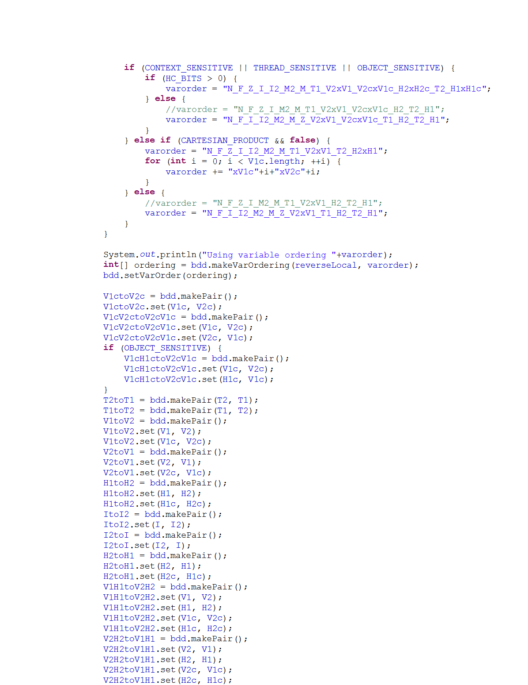
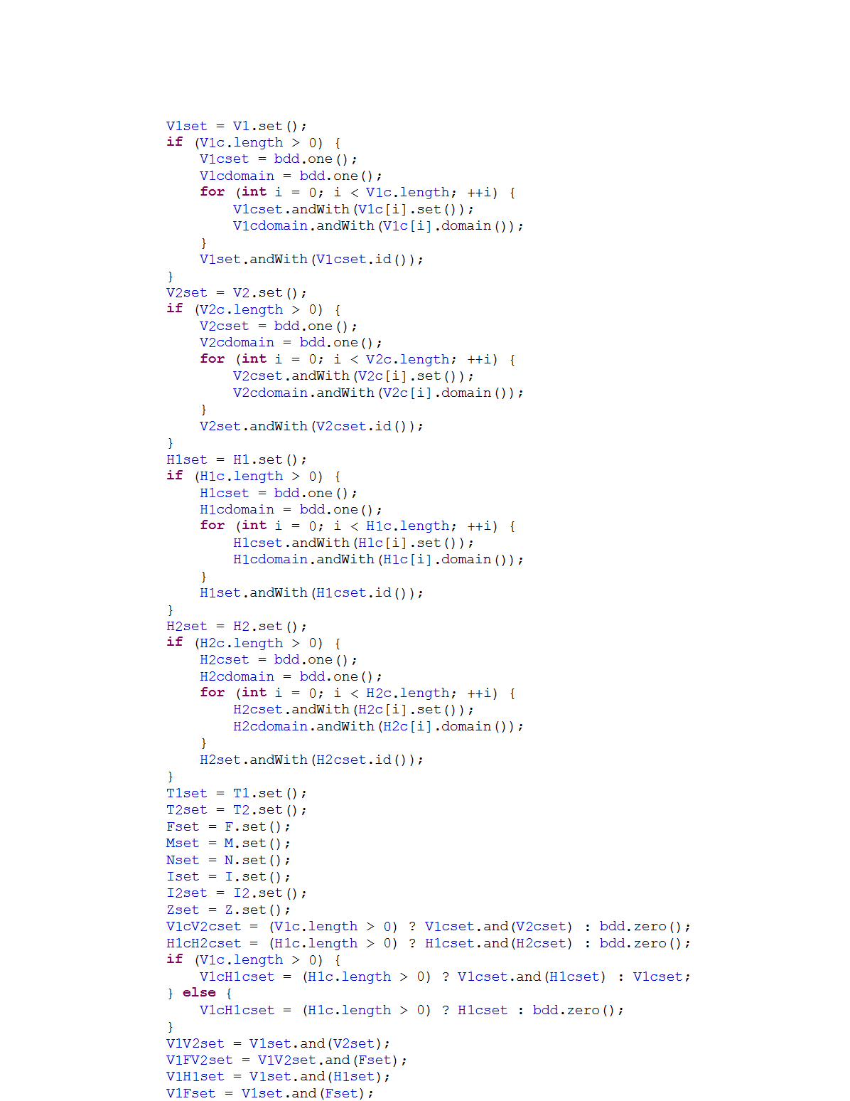

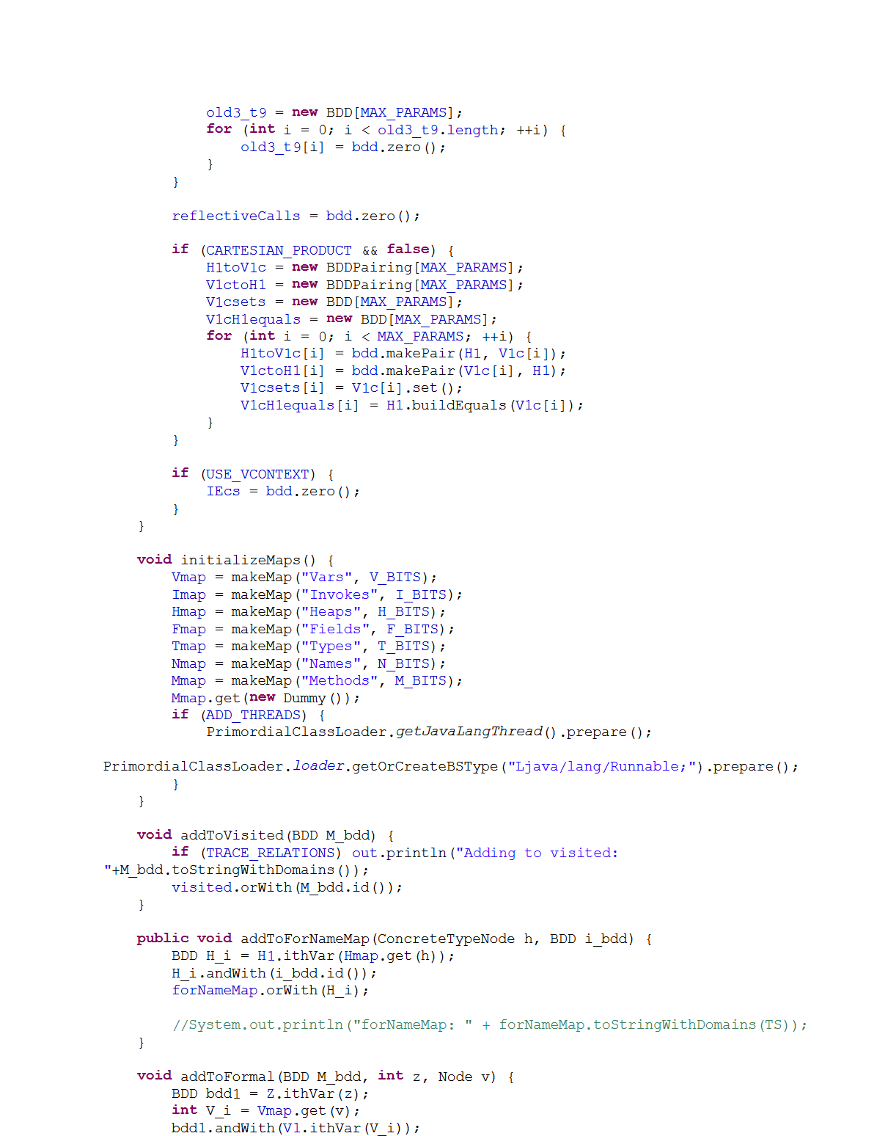
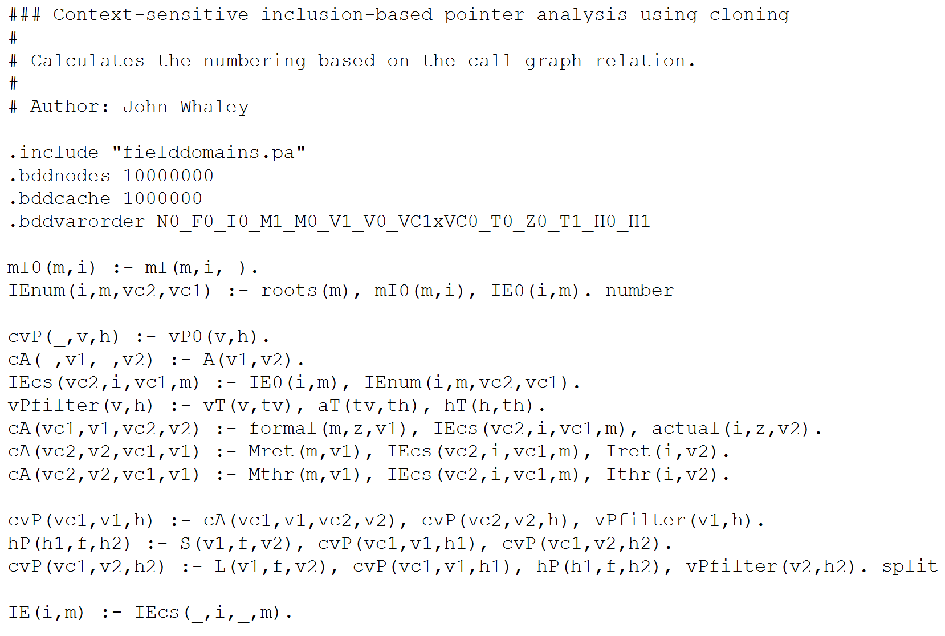
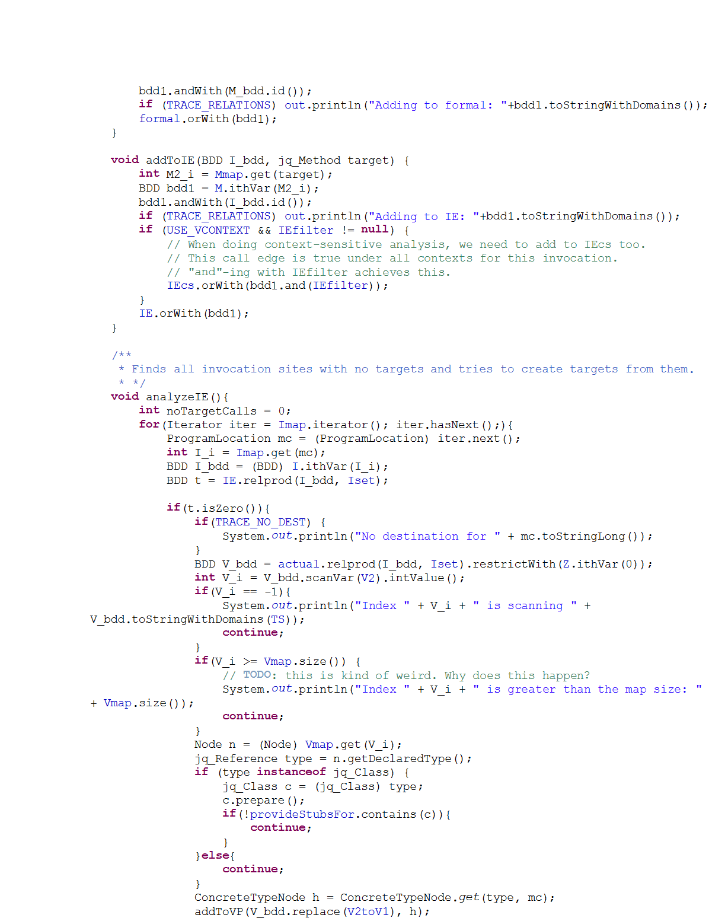
Why Datalog?
vs.
…56 pages!
Fewer bugs
Extensible
Runs faster

Slide 15
Applying the Analysis to a Program
1 public class RequestHandler {
2 Request request; 3 FtpWriter writer; 4 BufferedReader reader; 5 Socket controlSocket; 6 boolean isConnectionClosed; 7 … 8 public Request getRequest() {
10 }
11 public void close() { 12 synchronized (this) { 13 if (isClosed)
14 return; 15 isClosed = true; 16 }
21 reader.close(); 22 reader = null; 23 controlSocket.close(); 24 controlSocket = null; 25 }
17 request.clear();
R1
18 request = null;
19 writer.close();
9 return request;
20 writer = null;
Code snippet of concurrent program Apache FTP Server
Notes:
In fact, there is only one datarace in this program, which is between Line 9 and line 17.
But JChord reports another four false alarms as it thinks the cleanup code can be executed by different threads simutanouesly.

Slide 16
Applying the Analysis to a Program
1 public class RequestHandler {
2 Request request; 3 FtpWriter writer; 4 BufferedReader reader; 5 Socket controlSocket; 6 boolean isConnectionClosed; 7 … 8 public Request getRequest() {
10 }
11 public void close() { 12 synchronized (this) { 13 if (isClosed)
14 return; 15 isClosed = true; 16 }
21 reader.close(); 22 reader = null; 23 controlSocket.close(); 24 controlSocket = null; 25 }
17 request.clear();
R2
18 request = null;
19 writer.close();
R3
9 return request;
20 writer = null;
R4
R5
Code snippet of concurrent program Apache FTP Server
Notes:
This in turn leads to four false alarms.
There are four false alarms which are derived because Jchord is not able to reason about the atomic test-and-set idiom and it considers line 11 to line 24 can be executed by different threads at the same time.
This actually reveals a more general observation. Most of the false alarms are the symptoms of very few root causes.
If we can resolve these few root causes, we can eliminate a lot of false alarms. That is exactly what our approach achieves.
Let focus on R2 and R3.

Slide 17
Applying the Analysis to a Program
1 public class RequestHandler {
2 Request request; 3 FtpWriter writer; 4 BufferedReader reader; 5 Socket controlSocket; 6 boolean isConnectionClosed; 7 … 8 public Request getRequest() {
10 }
11 public void close() { 12 synchronized (this) { 13 if (isClosed)
14 return; 15 isClosed = true; 16 }
21 reader.close(); 22 reader = null; 23 controlSocket.close(); 24 controlSocket = null; 25 }
17 request.clear();
// x1
// x2
// y1
// y2
18 request = null;
19 writer.close();
9 return request;
20 writer = null;
Code snippet of concurrent program Apache FTP Server
Notes:
I am going to use static datarace analysis as an example to explain how we address these two challenges. We study Datarace as it is fundamental to detecting concurrency bugs for programs in this multi-core era. The analysis tool we consider is JChord, a popular static datarace detection tool. This code fragment is taken from a widely-used program, called Apache FTP server.
Class RequestHandler handles incoming FTP requests. Whenever a new request comes, a new object of this class is created. There are a lot of fields in this object, which can be accessed by multiple threads simultaneously. This in turn can lead to potential dataraces.
We mainly look at two methods. Method getRequest() returns the request field. Method close is invoked when the ftp connection is being closed, and cleans up the states of the object.
To prevent dataraces incurred by the cleanup code from Line 17 to Line 24, a flag isClosed is set. And to prevent dataraces on this flag itself, a synchronization block guards the code accessing it. This pattern is called atomic test-and-set idiom.
Let’s see how it works.

Slide 18
How Does Datalog Work?
…
request.clear(); // x1
next(x2,x1)
parallel(x1,x1)
request = null; // x2
writer.close(); // y1
¬guarded(x2, x1)
mayAlias(x2,x1)
parallel(x2,x1)
writer = null; // y2
…
race(x2,x1)
parallel(x1,x2)
next(x2,x1)
next(y1,x2)
parallel(x2,x2)
parallel(p3, p2) :- parallel(p1, p2), next (p3, p1).
parallel(p1, p2) :- parallel(p2, p1).
race(p1, p2) :- parallel(p1, p2), mayAlias(p1, p2),
¬guarded(p1, p2).
…
parallel(y1,x2)
next(y1,x2)
parallel(x2,y1)
parallel(y1,y1)
next(y2,y1)
mayAlias(y2,y1)
parallel(y2,y1)
¬guarded(y2, y1)
race(y2,y1)
Notes:
Here is the code fragment that is related to these two reports.
We run the probabilistic analysis on it and get a derivation graph on the right.
All the hyperedges represent the rule instances, where the dotted edges represent soft rule instances, and the solid edges represent hard rule instances.
Here are the two false alarms derived.
Let’s say Bob inspects race(x2,x1) and the source code, and finds it to be a false alarm, he gives negative feedback.
This negative feedback is encoded as a soft rule with weight 25 in the system.
After adding the user feedback, we notice that the subgraph here form a conflict.
Because this rule instance is hard and the user feedback has a higher weight than this soft rule instance has, we choose to violate this soft rule instance.

Slide 19
How To Go From This …
Notes:
TODO: Mark TP and FP
These are the datarace reports produced by Jchord. As we just described, it contains both the real bug and the four false alarms. Note Jchord doesn’t report acesses on the isClosed flag as a Datarace because it is able to reason about locks and synchronization blocks.
Normally, this is where the tool stops, and the user, Bob has to inspect each report manually, and then discharges the false alarms and fix the real bugs.

Slide 20
… To This?
Notes:
Then our approach will incorporate this feedback, and eliminate all the other false alarms that are derived because of similar reasons.

Slide 21
An Idea: Mixed Hard and Soft Rules
Analysis inputs:
next(p1, p2), mayAlias(p1, p2), guarded(p1, p2)
Analysis outputs:
parallel(p1, p2), race(p1, p2)
Analysis rules:
parallel(p3, p2) :- parallel(p1, p2), next (p3, p1).
(2) parallel(p1, p2) :- parallel(p2, p1).
race(p1, p2) :- parallel(p1, p2), mayAlias(p1, p2), ¬guarded(p1, p2).
…
a = 1;
if (a > 2) { // p1
... // p3
}
“Soft” Rule
weight 5
“Hard” Rule
Notes:
We attach a weight 5 to it, which is learned from labeled data.
As for the other two rules, we keep them hard as they are fairly precise.
We also add the user feedback as a soft rule.

Slide 22
A Long History …
parallel(p3, p2) :- parallel(p1, p2), next (p3, p1).
weight 5
Logic
Probability
1988: Bayesian Networks [Pearl]
1996: Stochastic Logic Programs (SLP) [Muggleton]
1999: Probabilistic Relational Models (PRM) [Koller]
2005: Bayesian Logic (BLOG) [Milch et al.]
2006: Markov Logic Network (MLN) [Richardson & Domingos]
2007: Probabilistic Prolog (ProbLog) [De Raedt et al.] …

Slide 23
From Derivation Trees to Bayesian Networks
next(x2,x1)
parallel(x1,x1)
¬guarded(x2, x1)
mayAlias(x2,x1)
parallel(x2,x1)
race(x2,x1)
parallel(p3,p2) :- parallel(p1,p2), next(p3,p1). probability 0.9
parallel(x1,x2)
next(x2,x1)
parallel(x1,x1) | next(x2,x1) | P(parallel(x2,x1) | parallel(x1,x1), next(x2,x1))
True | True | 0.9
True | False | 0
False | True | 0
False | False | 0
next(y1,x2)
parallel(x2,x2)
parallel(y1,x2)
next(y1,x2)
parallel(x2,y1)
parallel(y1,y1)
next(y2,y1)
parallel(x2,x1) may only hold if parallel(x1,x1) and next(x2,x1) are true.
mayAlias(y2,y1)
parallel(y2,y1)
¬guarded(y2, y1)
race(y2,y1)
Notes:
Also talk about:
Cycle elimination
Multiple derivation trees and disjunctive nodes

Slide 24
Marginal Inference in Bayesian Networks
next(x2,x1)
parallel(x1,x1)
¬guarded(x2, x1)
mayAlias(x2,x1)
parallel(x2,x1)
Marginal inference performed using off-the-shelf solvers (LibDAI, Dlib, Infer.Net, etc.)
race(x2,x1)
parallel(x1,x2)
next(x2,x1)
P(race(x2,x1)) | = | P(race(x2,x1), ¬guarded(x2,x1), mayAlias(x2,x1), parallel(x2,x1))
P(race(x2,x1)) | = | P(race(x2,x1), ¬guarded(x2,x1), mayAlias(x2,x1), parallel(x2,x1))
 | + | P(race(x2,x1), ¬guarded(x2,x1), mayAlias(x2,x1), ¬parallel(x2,x1))
 | + | P(race(x2,x1), ¬guarded(x2,x1), ¬mayAlias(x2,x1), parallel(x2,x1))
 | + | ⋯
 | + | P(race(x2,x1),guarded(x2,x1), ¬mayAlias(x2,x1), ¬parallel(x2,x1))
 | = | P(race(x2,x1) | ¬guarded(x2,x1), mayAlias(x2,x1), parallel(x2,x1)) *
 |  | P(¬guarded(x2,x1)) * P(mayAlias(x2,x1)) * P(parallel(x2,x1))
 | = | P(race(x2,x1) | ¬guarded(x2,x1), mayAlias(x2,x1), parallel(x2,x1)) *
 |  | P(parallel(x2,x1) | next(x2,x1), parallel(x1,x1)) * P(parallel(x1,x1))
 | = | 0.9 * 0.9 * P(parallel(x1,x1))
next(y1,x2)
parallel(x2,x2)
parallel(y1,x2)
next(y1,x2)
parallel(x2,y1)
parallel(y1,y1)
next(y2,y1)
0. If any of the antecedents fail, then the race cannot happen.
parallel(y2,y1)
¬guarded(y2, y1)
mayAlias(y2,y1)
race(y2,y1)

Slide 25
Recap of Key Concepts
Observation: alarms are correlated
Both true alarms and false alarms
Our insight: exploit derivations to capture correlations
View derivation graph as mix of hard / soft constraints
Encode as Bayesian network to perform marginal inference

Slide 26
Talk Outline
Challenges in Automated Program Reasoning
Combined Logical and Probabilistic Approach
Using the Approach in Interactive Techniques
Alarm Classification
Alarm Ranking
Alarm Resolution
Conclusions and Outlook

Slide 27
Analysis Writer
Analysis User
Analysis results
User feedback
Logical
Analysis
Learning Engine
Probabi-listic
Analysis
Inference Engine
________ ______ ________ ______
______ _________ ______ _______
Test program
Training programs with labeled alarms

Slide 28
Alarm Classification
A User-Guided Approach to Program Analysis. R. Mangal, X. Zhang, A. Nori, M. Naik. In Symposium on Foundations of Software Engineering (FSE), 2015.

Slide 29

Analysis Result, Before User Feedback
Notes:
On the other hand, our approach will allow the analysis tool to incorporate user feedback as Bob inspects the bug reports. One simplest form of user feedback is binary likes and dislikes.
Let’s say, Bob inspects the report R2 and finds it to be a false alarm. So he gives a negative feedback to this report.

Slide 30
Analysis Result, After User Feedback
Notes:
Then our approach will incorporate this feedback, and eliminate all the other false alarms that are derived because of similar reasons.

Slide 31
Datarace Analysis: Logical Probabilistic
Input relations:
next(p1, p2), mayAlias(p1, p2), guarded(p1, p2)
Output relations:
parallel(p1, p2), race(p1, p2)
Rules:
parallel(p3, p2) :- parallel(p1, p2), next (p3, p1).
(2) parallel(p1, p2) :- parallel(p2, p1).
race(p1, p2) :- parallel(p1, p2), mayAlias(p1, p2), ¬guarded(p1, p2).
…
¬race(x2, x1).
weight 5
weight 25
Notes:
We attach a weight 5 to it, which is learned from labeled data.
As for the other two rules, we keep them hard as they are fairly precise.
We also add the user feedback as a soft rule.

Slide 32
How Does Generalization Work?
…
request.clear(); // x1
next(x2,x1)
parallel(x1,x1)
request = null; // x2
writer.close(); // y1
¬guarded(x2, x1)
mayAlias(x2,x1)
parallel(x2,x1)
writer = null; // y2
…
race(x2,x1)
parallel(x1,x2)
next(x2,x1)
¬race(x2, x1) weight 25
next(y1,x2)
parallel(x2,x2)
parallel(p3, p2) :- parallel(p1, p2),
next (p3, p1). weight 5
parallel(p1, p2) :- parallel(p2, p1).
race(p1, p2) :- parallel(p1, p2), mayAlias(p1, p2),
¬guarded(p1, p2).
…
parallel(y1,x2)
next(y1,x2)
parallel(x2,y1)
parallel(y1,y1)
next(y2,y1)
mayAlias(y2,y1)
parallel(y2,y1)
¬guarded(y2, y1)
race(y2,y1)
Notes:
Here is the code fragment that is related to these two reports.
We run the probabilistic analysis on it and get a derivation graph on the right.
All the hyperedges represent the rule instances, where the dotted edges represent soft rule instances, and the solid edges represent hard rule instances.
Here are the two false alarms derived.
Let’s say Bob inspects race(x2,x1) and the source code, and finds it to be a false alarm, he gives negative feedback.
This negative feedback is encoded as a soft rule with weight 25 in the system.
After adding the user feedback, we notice that the subgraph here form a conflict.
Because this rule instance is hard and the user feedback has a higher weight than this soft rule instance has, we choose to violate this soft rule instance.

Slide 33
How Does Generalization Work?
…
request.clear(); // x1
next(x2,x1)
parallel(x1,x1)
request = null; // x2
writer.close(); // y1
¬guarded(x2, x1)
mayAlias(x2,x1)
parallel(x2,x1)
writer = null; // y2
…
race(x2,x1)
parallel(x1,x2)
next(x2,x1)
¬race(x2, x1) weight 25
next(y1,x2)
parallel(x2,x2)
parallel(p3, p2) :- parallel(p1, p2),
next (p3, p1). weight 5
parallel(p1, p2) :- parallel(p2, p1).
race(p1, p2) :- parallel(p1, p2), mayAlias(p1, p2),
¬guarded(p1, p2).
…
parallel(y1,x2)
next(y1,x2)
parallel(x2,y1)
parallel(y1,y1)
next(y2,y1)
mayAlias(y2,y1)
parallel(y2,y1)
¬guarded(y2, y1)
race(y2,y1)
Notes:
Look messy. Change to another format.

Slide 34
How Does Generalization Work?
…
request.clear(); // x1
next(x2,x1)
parallel(x1,x1)
request = null; // x2
writer.close(); // y1
¬guarded(x2, x1)
mayAias(x2,x1)
parallel(x2,x1)
writer = null; // y2
…
race(x2,x1)
parallel(x1,x2)
next(x2,x1)
¬race(x2, x1) weight 25
next(y1,x2)
parallel(x2,x2)
parallel(p3, p2) :- parallel(p1, p2),
next (p3, p1). weight 5
parallel(p1, p2) :- parallel(p2, p1).
race(p1, p2) :- parallel(p1, p2), mayAlias(p1, p2),
¬guarded(p1, p2).
…
parallel(y1,x2)
next(y1,x2)
parallel(x2,y1)
parallel(y1,y1)
next(y2,y1)
mayAias(y2,y1)
parallel(y2,y1)
¬guarded(y2, y1)
race(y2,y1)
Notes:
As a result, both parallel(x2,x1) and race(x2,x1) are eliminated.

Slide 35
How Does Generalization Work?
…
request.clear(); // x1
next(x2,x1)
parallel(x1,x1)
request = null; // x2
writer.close(); // y1
¬guarded(x2, x1)
mayAias(x2,x1)
parallel(x2,x1)
writer = null; // y2
…
race(x2,x1)
parallel(x1,x2)
next(x2,x1)
¬race(x2, x1) weight 25
next(y1,x2)
parallel(x2,x2)
parallel(p3, p2) :- parallel(p1, p2),
next (p3, p1). weight 5
parallel(p1, p2) :- parallel(p2, p1).
race(p1, p2) :- parallel(p1, p2), mayAlias(p1, p2),
¬guarded(p1, p2).
…
parallel(y1,x2)
next(y1,x2)
parallel(x2,y1)
parallel(y1,y1)
next(y2,y1)
mayAias(y2,y1)
parallel(y2,y1)
¬guarded(y2, y1)
race(y2,y1)
Notes:
At the same time, we have also implicitly encode the least fixpoint semantics of these rules. As a result, all tuples that depend on parallel(x2,x1) will be also eliminated. So we successfully remove the other false alarm race(y2,y1).

Slide 36
Experimental Setup
Analyses:
Programs:
58 input relations
44 output relations
102 rules
52 input relations
25 output relations
62 rules
Race conditions checker Information flow checker
concurrent Java programs Symentec Android apps
(~ 50-550 KB in size) (~ 68-81 KB in size)

Slide 37
Accuracy of Alarm Classification
feedback on 5% reports
338 700
324 119
111 153
1824 2597
79 183
0 10
Notes:
Let’s first look at the precision result, Because the time is limited, I will only talk about the result for Datarace. The result for pointer analysis is similar.
We obtained the result by randomly sampling 5% of the reports to give feedback on.
Each group of bars represents the result on one benchmark, where the orange bar represents the percentage of false alarms that is eliminated by our approach, and blue bar represents the percentage of true alarms that are retained.
The numbers at the top are the absolute numbers of false alarms and true alarms produced by the original analysis.
Because we have made the analysis probabilistic, sometimes we will have some false negatives.
For both bars, the higher, the better.
On average, our approach is able to eliminate 70% of the false alarms by incorporating 5% of the feedback at the cost of introducing 4% false negatives.

Slide 38
Accuracy of Alarm Classification
feedback on 5% reports
338 700
324 119
111 153
1824 2597
79 183
0 10
With only up to 5% feedback, 70% of the false positives are eliminated and 96% of true positives retained.
Notes:
Let’s first look at the precision result, Because the time is limited, I will only talk about the result for Datarace. The result for pointer analysis is similar.
We obtained the result by randomly sampling 5% of the reports to give feedback on.
Each group of bars represents the result on one benchmark, where the orange bar represents the percentage of false alarms that is eliminated by our approach, and blue bar represents the percentage of true alarms that are retained.
The numbers at the top are the absolute numbers of false alarms and true alarms produced by the original analysis.
Because we have made the analysis probabilistic, sometimes we will have some false negatives.
For both bars, the higher, the better.
On average, our approach is able to eliminate 70% of the false alarms by incorporating 5% of the feedback at the cost of introducing 4% false negatives.

Slide 39
Alarm Ranking
Interactive Program Reasoning using Bayesian Inference. M. Raghothaman, S. Kulkarni, K. Heo, M. Naik.

Slide 40

Confidence | Detected Races
0.81 | R2: Race on field org.apache.ftpserver.RequestHandler.request
 | org.apache.ftpserver.RequestHandler:17 | org.apache.ftpserver.RequestHandler:18
0.53 | R3: Race on field org.apache.ftpserver.RequestHandler.writer
 | org.apache.ftpserver.RequestHandler:19 | org.apache.ftpserver.RequestHandler:20
0.35 | R4: Race on field org.apache.ftpserver.RequestHandler.reader
 | org.apache.ftpserver.RequestHandler:21 | org.apache.ftpserver.RequestHandler:22
0.30 | R1: Race on field org.apache.ftpserver.RequestHandler.request
 | org.apache.ftpserver.RequestHandler:9 | org.apache.ftpserver.RequestHandler:18
0.23 | R5: Race on field org.apache.ftpserver.RequestHandler.controlSocket
 | org.apache.ftpserver.RequestHandler:23 | org.apache.ftpserver.RequestHandler:24

Slide 41
next(x2,x1)
parallel(x1,x1)
¬guarded(x2, x1)
mayAlias(x2,x1)
parallel(x2,x1)
By Bayes’ Rule,
P(parallel(x2,x1) | ¬race(x2,x1)) = P(¬race(x2,x1) | parallel(x2,x1)) * P(parallel(x2,x1)) / P(¬race(x2,x1))
= 0.1 * 0.9 / (1 - 0.81) = 0.47
race(x2,x1)
parallel(x1,x2)
next(x2,x1)
next(y1,x2)
parallel(x2,x2)
parallel(y1,x2)
P(race(y2,y1) | ¬race(x2,x1)) = P(race(y2,y1) | parallel(x2,x1)) * P(parallel(x2,x1) | ¬race(x2,x1))
= 0.9⁵ * 0.47 = 0.28
next(y1,x2)
parallel(x2,y1)
parallel(y1,y1)
next(y2,y1)
mayAlias(y2,y1)
parallel(y2,y1)
¬guarded(y2, y1)
race(y2,y1)
Notes:
Observe that the posterior probability, P(parallel(x2,x1) | ¬race(x2,x1)) = 0.47 is significantly lower than the prior, P(parallel(x2,x1)) = 0.9.
P(race(y2,y1)) was originally 0.53. The posterior is significantly lower: P(race(y2,y1) | ¬race(x2,x1)) = 0.28.

Slide 42
Confidence | Detected Races
0 | R2: Race on field org.apache.ftpserver.RequestHandler.request
 | org.apache.ftpserver.RequestHandler:17 | org.apache.ftpserver.RequestHandler:18
0.81
0.28 | R3: Race on field org.apache.ftpserver.RequestHandler.writer
 | org.apache.ftpserver.RequestHandler:19 | org.apache.ftpserver.RequestHandler:20
0.53
0.18 | R4: Race on field org.apache.ftpserver.RequestHandler.reader
 | org.apache.ftpserver.RequestHandler:21 | org.apache.ftpserver.RequestHandler:22
0.35
0.30 | R1: Race on field org.apache.ftpserver.RequestHandler.request
 | org.apache.ftpserver.RequestHandler:9 | org.apache.ftpserver.RequestHandler:18
0.30
0.12 | R5: Race on field org.apache.ftpserver.RequestHandler.controlSocket
 | org.apache.ftpserver.RequestHandler:23 | org.apache.ftpserver.RequestHandler:24
0.23
P(Ri | ¬ R2)

Slide 43
Confidence | Detected Races
0 | R2: Race on field org.apache.ftpserver.RequestHandler.request
 | org.apache.ftpserver.RequestHandler:17 | org.apache.ftpserver.RequestHandler:18
0.28 | R3: Race on field org.apache.ftpserver.RequestHandler.writer
 | org.apache.ftpserver.RequestHandler:19 | org.apache.ftpserver.RequestHandler:20
0.18 | R4: Race on field org.apache.ftpserver.RequestHandler.reader
 | org.apache.ftpserver.RequestHandler:21 | org.apache.ftpserver.RequestHandler:22
0.30 | R1: Race on field org.apache.ftpserver.RequestHandler.request
 | org.apache.ftpserver.RequestHandler:9 | org.apache.ftpserver.RequestHandler:18
0.12 | R5: Race on field org.apache.ftpserver.RequestHandler.controlSocket
 | org.apache.ftpserver.RequestHandler:23 | org.apache.ftpserver.RequestHandler:24
P(Ri | ¬ R2)

Slide 44
Empirical Results: Alarm Ranking
 | Graph size |  | Alarms |  | FP rate | AUC
 | Tuples | Clauses | Total | Bugs
Race conditions checker
weblech | 2.5K | 1.5K | 188 | 55 | 71% | 0.88
hedc | 12K | 10K | 152 | 9 | 94% | 0.71
jspider | 45K | 45K | 257 | 7 | 97% | 0.87
ftpserver | 110K | 112K | 522 | 75 | 86% | 0.97
Information flow checker
AndorsTrail | 2.7K | 3.2K | 156 | 7 | 96% | 0.99
kQm-LO | 12K | 18K | 817 | 160 | 81% | 0.94
gingermaster | 15K | 20K | 437 | 87 | 80% | 0.88
iNJ-Cw | 17K | 24K | 1,012 | 248 | 76% | 0.91

Slide 45
Ranking Quality: Race Conditions Checker

Slide 46
Ranking Quality: Information Flow Checker

Slide 47
Alarm Resolution
Effective Interactive Resolution of Static Analysis Alarms. X. Zhang, R. Grigore, X. Si, M. Naik. In Conference on Object-Oriented Programming, Systems, Languages, and Applications (OOPSLA), 2017.

Slide 48
Example Revisited: Static Datarace Analysis
1 public class RequestHandler {
2 Request request; 3 FtpWriter writer; 4 BufferedReader reader; 5 Socket controlSocket; 6 boolean isConnectionClosed; 7 … 8 public Request getRequest() {
10 }
11 public void close() { 12 synchronized (this) { 13 if (isClosed)
14 return; 15 isClosed = true; 16 }
21 reader.close(); 22 reader = null; 23 controlSocket.close(); 24 controlSocket = null; 25 }
Can this statement be executed by different threads in parallel?
17 request.clear();
18 request = null;
19 writer.close();
9 return request;
20 writer = null;
Source code snippet from Apache FTP Server
Notes:
I am going to use static datarace analysis as an example to explain how we address these two challenges. We study Datarace as it is fundamental to detecting concurrency bugs for programs in this multi-core era. The analysis tool we consider is JChord, a popular static datarace detection tool. This code fragment is taken from a widely-used program, called Apache FTP server.
Class RequestHandler handles incoming FTP requests. Whenever a new request comes, a new object of this class is created. There are a lot of fields in this object, which can be accessed by multiple threads simultaneously. This in turn can lead to potential dataraces.
We mainly look at two methods. Method getRequest() returns the request field. Method close is invoked when the ftp connection is being closed, and cleans up the states of the object.
To prevent dataraces incurred by the cleanup code from Line 17 to Line 24, a flag isClosed is set. And to prevent dataraces on this flag itself, a synchronization block guards the code accessing it. This pattern is called atomic test-and-set idiom.
Let’s see how it works.

Slide 49
Space of Questions
…
request.clear(); // x1
next(x2,x1)
parallel(x1,x1)
request = null; // x2
writer.close(); // y1
¬guarded(x2, x1)
mayAlias(x2,x1)
parallel(x2,x1)
writer = null; // y2
…
race(x2,x1)
parallel(x1,x2)
next(x2,x1)
next(y1,x2)
parallel(x2,x2)
parallel(p3, p2) :- parallel(p1, p2), next (p3, p1).
parallel(p1, p2) :- parallel(p2, p1).
race(p1, p2) :- parallel(p1, p2), mayAlias(p1, p2), ¬guarded(p1, p2).
…
parallel(y1,x2)
next(y1,x2)
parallel(x2,y1)
parallel(y1,y1)
next(y2,y1)
mayAlias(y2,y1)
parallel(y2,y1)
¬guarded(y2, y1)
race(y2,y1)
Notes:
As a result, both parallel(x2,x1) and race(x2,x1) are eliminated.

Slide 50
Space of Questions
…
request.clear(); // x1
next(x2,x1)
parallel(x1,x1)
request = null; // x2
writer.close(); // y1
¬guarded(x2, x1)
mayAlias(x2,x1)
parallel(x2,x1)
writer = null; // y2
…
race(x2,x1)
parallel(x1,x2)
next(x2,x1)
next(y1,x2)
parallel(x2,x2)
parallel(p3, p2) :- parallel(p1, p2), next (p3, p1).
parallel(p1, p2) :- parallel(p2, p1).
race(p1, p2) :- parallel(p1, p2), mayAlias(p1, p2), ¬guarded(p1, p2).
…
parallel(y1,x2)
next(y1,x2)
parallel(x2,y1)
parallel(y1,y1)
next(y2,y1)
mayAlias(y2,y1)
parallel(y2,y1)
¬guarded(y2, y1)
race(y2,y1)
Notes:
As a result, both parallel(x2,x1) and race(x2,x1) are eliminated.

Slide 51
Space of Questions
…
request.clear(); // x1
next(x2,x1)
parallel(x1,x1)
request = null; // x2
writer.close(); // y1
¬guarded(x2, x1)
mayAlias(x2,x1)
parallel(x2,x1)
writer = null; // y2
…
race(x2,x1)
parallel(x1,x2)
next(x2,x1)
next(y1,x2)
parallel(x2,x2)
parallel(p3, p2) :- parallel(p1, p2), next (p3, p1).
parallel(p1, p2) :- parallel(p2, p1).
race(p1, p2) :- parallel(p1, p2), mayAlias(p1, p2), ¬guarded(p1, p2).
…
parallel(y1,x2)
next(y1,x2)
parallel(x2,y1)
parallel(y1,y1)
next(y2,y1)
mayAlias(y2,y1)
parallel(y2,y1)
¬guarded(y2, y1)
race(y2,y1)
Notes:
As a result, both parallel(x2,x1) and race(x2,x1) are eliminated.

Slide 52
Two Key Objectives
Generalization
Number of Questions << Number of Alarms Resolved
Prioritization
Prioritize Questions Likely to Resolve the Most Alarms

Slide 53
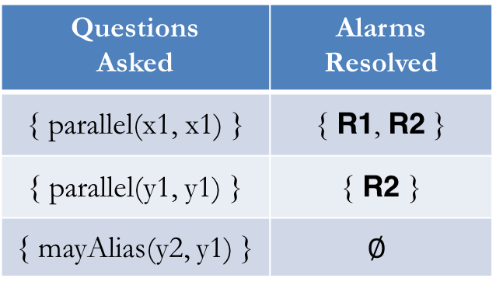
Payoff Comparison
…
request.clear(); // x1
next(x2,x1)
parallel(x1,x1)
request = null; // x2
writer.close(); // y1
¬guarded(x2, x1)
mayAlias(x2,x1)
parallel(x2,x1)
writer = null; // y2
…
R1
race(x2,x1)
parallel(x1,x2)
next(x2,x1)
next(y1,x2)
parallel(x2,x2)
Questions Asked | Alarms Resolved
{ parallel(x1, x1) } | { R1, R2 }
{ parallel(y1, y1) } | { R2 }
{ mayAlias(y2, y1) } | $$∅$$
parallel(y1,x2)
next(y1,x2)
parallel(x2,y1)
parallel(y1,y1)
next(y2,y1)
mayAlias(y2,y1)
parallel(y2,y1)
¬guarded(y2, y1)
race(y2,y1)
R2
Notes:
As a result, both parallel(x2,x1) and race(x2,x1) are eliminated.

Slide 54
Empirical Results: Generalization
total false and true reports
226
185
64 0
100 0
214 50
594
317
Notes:
Let’s first look at the precision result, Because the time is limited, I will only talk about the result for Datarace. The result for pointer analysis is similar.
We obtained the result by randomly sampling 5% of the reports to give feedback on.
Each group of bars represents the result on one benchmark, where the orange bar represents the percentage of false alarms that is eliminated by our approach, and blue bar represents the percentage of true alarms that are retained.
The numbers at the top are the absolute numbers of false alarms and true alarms produced by the original analysis.
Because we have made the analysis probabilistic, sometimes we will have some false negatives.
For both bars, the higher, the better.
On average, our approach is able to eliminate 70% of the false alarms by incorporating 5% of the feedback at the cost of introducing 4% false negatives.

Slide 55
Empirical Results: Generalization
total false and true reports
226
185
64 0
100 0
214 50
594
317
With only up to 5% questions, 74% of the false alarms are resolved with average payoff of 12X per question.
Notes:
Let’s first look at the precision result, Because the time is limited, I will only talk about the result for Datarace. The result for pointer analysis is similar.
We obtained the result by randomly sampling 5% of the reports to give feedback on.
Each group of bars represents the result on one benchmark, where the orange bar represents the percentage of false alarms that is eliminated by our approach, and blue bar represents the percentage of true alarms that are retained.
The numbers at the top are the absolute numbers of false alarms and true alarms produced by the original analysis.
Because we have made the analysis probabilistic, sometimes we will have some false negatives.
For both bars, the higher, the better.
On average, our approach is able to eliminate 70% of the false alarms by incorporating 5% of the feedback at the cost of introducing 4% false negatives.

Slide 56
Empirical Results: Prioritization
Notes:
Let’s first look at the precision result, Because the time is limited, I will only talk about the result for Datarace. The result for pointer analysis is similar.
We obtained the result by randomly sampling 5% of the reports to give feedback on.
Each group of bars represents the result on one benchmark, where the orange bar represents the percentage of false alarms that is eliminated by our approach, and blue bar represents the percentage of true alarms that are retained.
The numbers at the top are the absolute numbers of false alarms and true alarms produced by the original analysis.
Because we have made the analysis probabilistic, sometimes we will have some false negatives.
For both bars, the higher, the better.
On average, our approach is able to eliminate 70% of the false alarms by incorporating 5% of the feedback at the cost of introducing 4% false negatives.

Slide 57
Empirical Results: Prioritization
Earlier iterations yield higher payoffs and match the performance of the ideal setting.
Notes:
Let’s first look at the precision result, Because the time is limited, I will only talk about the result for Datarace. The result for pointer analysis is similar.
We obtained the result by randomly sampling 5% of the reports to give feedback on.
Each group of bars represents the result on one benchmark, where the orange bar represents the percentage of false alarms that is eliminated by our approach, and blue bar represents the percentage of true alarms that are retained.
The numbers at the top are the absolute numbers of false alarms and true alarms produced by the original analysis.
Because we have made the analysis probabilistic, sometimes we will have some false negatives.
For both bars, the higher, the better.
On average, our approach is able to eliminate 70% of the false alarms by incorporating 5% of the feedback at the cost of introducing 4% false negatives.

Slide 58



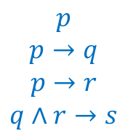
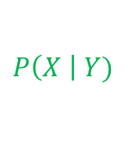
Conclusions and Outlook
Human In the Loop
Combining Logic With Probability
Program
Reasoning
Tool
$$p$$
$$p→q$$
$$p→r$$
$$q∧r→s$$
$$P\left(X \right| Y)$$
Optimization Solvers
Data-Driven
SMT
SAT
Datalog
MaxSAT
MaxSMT
Markov Logic Network
Probabilistic Soft Logic
…
Notes:
Our current work reveals four future research directions that we believe will change program reasoning techniques fundamentally. These four directions complement each other and our current work has only begun to reveal their potential.
The first direction is bringing human into the loop. Today’s techniques are either mostly automatic or mostly manual. However, I don’t believe either extreme is the right approach. For example, humans have domain knowledge and are very good at local reasoning, while automatic techniques are very good at handling tedious tasks and global reasoning. Therefore, the right approach should be an approach that systematically combines human capabilities and automatic techniques.
The second direction we’re investigating is to combine logical and probabilistic reasoning. Conventional program analyses have made great strides by leveraging logical reasoning. The logical approach provides many benefits. However, it cannot handle uncertainties very well, and lacks the ability to learn and adapt. On the other hand, the probabilistic approach doesn’t have these limitations. However, we don’t’ want to switch to a purely probabilistic approach because we want to keep the benefits of conventional program analysis. Therefore, the right approach should be a combined approach.
The third direction we’re investigating is optimization solvers. The constraint-based approach has emerged as a new computational paradigm in many fields of computer science. One example is the use of decision solvers, including SAT and Datalog solvers. Nowadays, researchers are trying to push forward the paradigm by investigating solvers with more expressiveness. One direction is to extend the current solvers to handle richer logic. One example of solvers that researchers are investigating is SMT solvers. Another direction that we’re investigating is to go from decision solvers to optimization solvers. In the future, we want both richer logic and the ability to express optimization objectives. One key challenge is how to develop efficient and accurate solving algorithms. One promising direction is to exploit domain knowledge.
The final direction we’re investigating is how to make program reasoning techniques data-driven. Currently, all conventional techniques depend mostly upon handcrafted knowledge. Why is this the case. There’re two reasons: 1there was not sufficient data availabel in the past. 2. all conventional approaches are based on logical reasoning, which is not effective at learning. But nowadays, we have a lot of open-source codebases and well-documented program errors and security vulnerabilities available. And researchers have started looking at how to incorporate probabilistic reasoning. These developments, taking together, lead me to believe there is a huge opportunity in improving the state of the art by levering data-driven approaches.

